Slide 1







Algorithm Analysis
Lecture 2
Page:1 Algorithm Complexity
https://livecodestream.dev/post/complete-guide-to-understanding-time-and-space-complexity-of-algorithms/

Slide 2



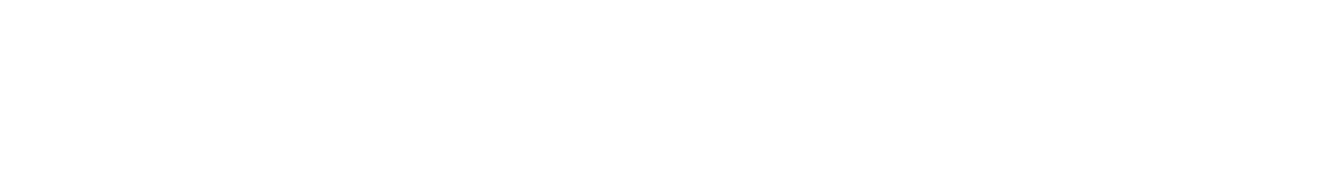


Recap Lecture 1
Data structures has wide applications
Design an efficient search engine, as good as Google’s
Build an efficient security system based on face recognition
Understand the human genome and trace your ancestry
Data structures are a key for designing efficient algorithms
What is an efficient algorithm ?
How do we know that algorithm is efficient ?
Page:2
Algorithm Complexity

Slide 3
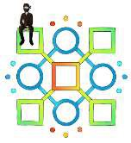
Recap Lecture 1
We need to analyze algorithm in term of time (efficiency)
Independent of Hardware, OS, and compiler
Introduced the concept of T(n) …logical time unit
Consider each operation (comparison, assignment) as a program step
To keep stuff simple we consider each operation cost is 1 unit of time
A sequence of operations:
count = count + 1;
sum = sum + count;
1 unit of time
1 unit of time
➔ Total Cost = 2
Don’t count comments and declarations
Page:3 Algorithm Complexity

Slide 4

Algorithm Analysis
Estimate the performance of an algorithm through
The number of operations required to process an input of certain size
Algorithm
Cost (time complexity)
i=0;
sum = 0;
while(i<N ){
sum ++;
i++
}
1
1
N+1 N
N
The cond executes o than the
ition always ne more time loop itself
T(N) = 1 + 1 + N+1 + N + N T(N) ⁼ 3N+3
Page:4
Algorithm Complexity
https://www.ft.com/content/d24fce5e-58fc-11e6-9f70-badea1b336d4

Slide 5
LECTURE 2

Slide 6
Complexity Analysis
For student
Chapter 2 of Alan Weiss’s book
Chapter 2 of Adam Drozdek’s book

Slide 7

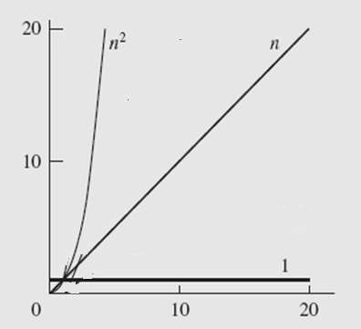
Analysis of Loop
Algorithm
Cost (time complexity)
i=0;
sum = 0;
while(i<N ){
sum ++; i++
}
1
1
N+1
N N
T(N) = 1 + 1 + N+1 + N + N T(N) ⁼ 3N+3
TWO important things to note
What is the effect of constant in T(N) = 3N + 3 ?
How T(n) varies for different N (input) ?
Check for N =5, 10, 20, 50, 100, 500, 1000, 10000, 100000

Slide 8



Analysis of Loop
8
N
N | T(N)= 3N+3
10 | 33
20 | 63
30 | 93
40 | 123
50 | 153
100 | 303
150 | 453
200 | 603
5000 | 15003
10000 | 30003
15000 | 45003
20000 | 60003
70000
60000
50000
40000
30000
3N+3
20000
10000
0
-5000
-10000
0
5000
10000
15000
20000
25000

Slide 9
NESTED Loop
9
Example: Nested Loop
Cost
Times
i=1; |  |  | 1 |  | 1
sum = | 0; |  | 1 |  | 1
while | (i | <= n) { | 1 |  | n+1
j=1; |  |  |  | 1 | n
while (j <= n) |  |  | { | 1 | n*(n+1)
sum += i; |  |  |  | 1 | n*n
j++; |  |  |  | 1 | n*n
}
i++; |  |  |  | 1 | n
}
T(N) = 1 + 1 + (n+1) + n + n*(n+1)+n*n+ n*n+ n = 3n² + 3n + 3
➔ The time required for this algorithm is proportional to n²

Slide 10

Analysis of Nested Loop
2 important things to Note
What is the effect of constant and low order term in in T(N) = 3N² + 3N+3 for large N ?
How T(n) varies for different N (input) ?
Check for N =5, 10, 20,50,100, 500, 1000, 10000 ,100000

Slide 11
Example: Effect of low order terms
If T(n) = 7n+100
What is T(n) for different values of n???
n | T(n) | Comment
1 | 107 | Contributing factor is 100

Slide 12
Example: Effect of low order terms
If T(n) = 7n+100
What is T(n) for different values of n???
n | T(n) | Comment
1 | 107 | Contributing factor is 100
5 | 135 | Contributing factor is 7n and 100
10 | 170 | Contributing factor is 7n and 100

Slide 13
Example: Effect of low order terms
If T(n) = 7n+100
What is T(n) for different values of n???
n | T(n) | Comment
1 | 107 | Contributing factor is 100
5 | 135 | Contributing factor is 7n and 100
10 | 170 | Contributing factor is 7n and 100
100 | 800 | Contribution of 100 is small

Slide 14
Example: Effect of low order terms
If T(n) = 7n+100
What is T(n) for different values of n???
n | T(n) | Comment
1 | 107 | Contributing factor is 100
5 | 135 | Contributing factor is 7n and 100
10 | 170 | Contributing factor is 7n and 100
100 | 800 | Contribution of 100 is small
1000 | 7100 | Contributing factor is 7n

Slide 15
Example: Effect of low order terms
If T(n) = 7n+100
What is T(n) for different values of n???
n | T(n) | Comment
1 | 107 | Contributing factor is 100
5 | 135 | Contributing factor is 7n and 100
10 | 170 | Contributing factor is 7n and 100
100 | 800 | Contribution of 100 is small
1000 | 7100 | Contributing factor is 7n
10000 | 70100 | Contributing factor is 7n

Slide 16
Example: Effect of low order terms
If T(n) = 7n+100
What is T(n) for different values of n???
n | T(n) | Comment
1 | 107 | Contributing factor is 100
5 | 135 | Contributing factor is 7n and 100
10 | 170 | Contributing factor is 7n and 100
100 | 800 | Contribution of 100 is small
1000 | 7100 | Contributing factor is 7n
10000 | 70100 | Contributing factor is 7n
10⁶ | 7000100 | What is the contributing factor????
DEDUCTION: When approximating T(n) we can IGNORE the 100 term for very large value of n and say that T(n) can be approximated by 7(n)

Slide 17
T(N)=cN and T(N)=N
Note we are estimating Algorithm complexity with reference to size of the input
T₁ (N)=N and T₂(N)=30N will have same effect with increase in input size
Effect of input size on above T(N)
N | T₁ (N)=N | T₂ (N)=30N
10 | t₁=10 | t₂=300

Slide 18
T(N)=cN and T(N)=N
Note we are estimating Algorithm complexity with reference to size of the input
T₁ (N)=N and T₂(N)=30N will have same effect with increase in input size
Effect of input size on above T(N)
N | T₁ (N)=N | T₂ (N)=30N
10 | t₁=10 | t₂=300
20 | 2t₁ | 2t₂

Slide 19
T(N)=cN and T(N)=N
Note we are estimating Algorithm complexity with reference to size of the input
T₁ (N)=N and T₂(N)=30N will have same effect with increase in input size
Effect of input size on above T(N)
N | T₁ (N)=N | T₂ (N)=30N
10 | t₁=10 | t₂=300
20 | 2t₁ | 2t₂
100 | 10t₁ | 10t₂
1000 | 100t₁ | 100t₂
NO difference in T(N) = N and T(N) = cN in terms
of the growth of time w.r.t input size

Slide 20
Example 2
T(n) = n² + 100n + log₁₀n +1000
n | T(n) | _{n}2 |  | 100n |  | log₁₀n |  | 1000
 |  | Val | % | Val | % | Val | % | Val | %
1 | 1101 | 1 | 0.1% | 100 | 9.1% | 0 | 0% | 1000 | 90.8%

Slide 21
Example 2
T(n) = n² + 100n + log₁₀n +1000
n | T(n) | _{n}2 |  | 100n |  | log₁₀n |  | 1000
 |  | Val | % | Val | % | Val | % | Val | %
1 | 1101 | 1 | 0.1% | 100 | 9.1% | 0 | 0% | 1000 | 90.8%
10 | 2101 | 100 | 5.8% | 1000 | 47.6% | 1 | 0.05% | 1000 | 47.6%

Slide 22
Example 2
T(n) = n² + 100n + log₁₀n +1000
n | T(n) | _{n}2 |  | 100n |  | log₁₀n |  | 1000
 |  | Val | % | Val | % | Val | % | Val | %
1 | 1101 | 1 | 0.1% | 100 | 9.1% | 0 | 0% | 1000 | 90.8%
10 | 2101 | 100 | 5.8% | 1000 | 47.6% | 1 | 0.05% | 1000 | 47.6%
100 | 21002 | 10000 | 47.6% | 10000 | 47.6% | 2 | 0.99% | 1000 | 4.76%

Slide 23
Example 2
T(n) = n² + 100n + log₁₀n +1000
n | T(n) | _{n}2 |  | 100n |  | log₁₀n |  | 1000
 |  | Val | % | Val | % | Val | % | Val | %
1 | 1101 | 1 | 0.1% | 100 | 9.1% | 0 | 0% | 1000 | 90.8%
10 | 2101 | 100 | 5.8% | 1000 | 47.6% | 1 | 0.05% | 1000 | 47.6%
100 | 21002 | 10000 | 47.6% | 10000 | 47.6% | 2 | 0.99% | 1000 | 4.76%
10⁵ | 10,010,001,005 | ₁₀10 | 99.9% | 10⁷ | .099% | 5 | 0.0% | 1000 | 0.00%
When approximating T(n) we can IGNORE the last 3 terms and say that T(n) can be approximated by n²

Slide 24



Rate of Growth
24
Consider the example of buying Gold and Metal jewelry
•
+
Cost: cost_of_gold + cost_of_metal
Cost ~ cost_of_gold (approximation)
Page:24
Algorithm Complexity

Slide 25
Rate of Growth
25
The low order terms in a function are relatively insignificant for
large n
n⁴ + 100n² + 10n + 50 ~
_{n}4
i.e., we say that n⁴ + 100n² + 10n + 50 and n⁴ have the same rate of growth
Thus,
we throw away leading constants & we also throw away low order terms.

Slide 26
Partial SUM
 |  | Cost
 | int sum( int n ) { int partialSum; partialSum = 0; for( int i = 1; i <= n; ++i ) partialSum += i * i * i; return partialSum; }
T(N)= 6N+4

Slide 27
Partial SUM
 |  | Cost
 | int sum( int n ) { int partialSum; partialSum = 0; for( int i = 1; i <= n; ++i ) partialSum += i * i * i; return partialSum; } | 0 1 i=1 cost is 1, i<=N cost is N+1 ++i cost is N
T(N)= 6N+4

Slide 28
Partial SUM
 |  | Cost
 | int sum( int n ) { | 0
 | int partialSum; partialSum = 0; for( int i = 1; i <= n; ++i ) | 1 i=1 cost is 1, i<=N cost is N+1
 |  | ++i cost is N
 | 3 partialSum += i * i * i; | 3 ops 1 assignment,
 | 4 return partialSum; } | 2 multiplication, 1 add Total 4 cost for line 3
 |  | ⁰ T(N)= 6N+4

Slide 29
Problems with T(n)
T(n) is also not very meaningful as step size is not exactly defined
T(n) is difficult to calculate
Approximation of T(n) is called ASYMPTOTIC COMPLEXITY
T(n) is usually very complicated so we need an approximation of T(n)….close to T(n).
Asymptotic complexity studies the efficiency of an
algorithm as the input size becomes large
Page:29
Algorithm Complexity

Slide 30
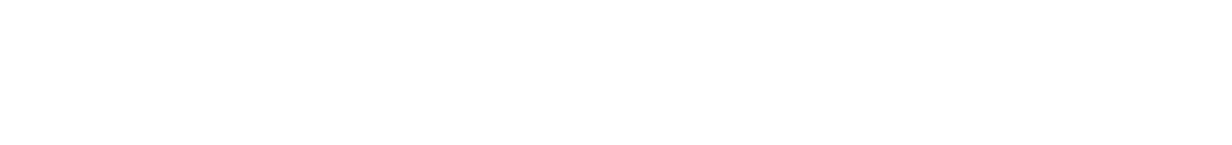

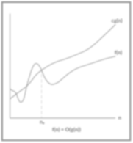
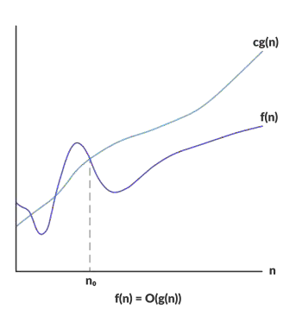
Big-Oh or Big-O
f(n) is O(g(n)) if there exist positive numbers c & n₀
such that f(n)<=cg(n) for all n>= n₀
g(n) is called the upper bound on f(n) OR f(n) grows at the most as large as g(n)

Slide 31
Big-Oh or Big-O
f(n) is O(g(n)) if there exist positive numbers c & n₀ such that f(n)<=cg(n) for
all n>= n₀
g(n) is called the upper bound on f(n) OR f(n) grows at the most as large as g(n)
Example:
T(n) = n² + 3n + 4
n² + 3n + 4 <= 2n² for all n₀ >10
What is f(n) and what is g(n)?
What is c & n
so we can say that T(n) is O(n²) OR
T(n) is in the order of n^{2.}
T(n) is bounded above by a + real multiple of n²

Slide 32

How to choose c and N
What is c & N
The definition of big-Oh states only that there must exist certain c and N,
but it does not give any hint of how to calculate these constants.
Second, it does not put any restrictions on these values and gives little guidance in situations when there are many candidates.
In fact, there are usually
given for the same pair of functions f and g.
that can be
infinitely many pairs of cs and Ns

Slide 33
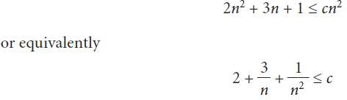
How to choose c and N
We obtain the value of c & n by solving the inequality
Put value of n=1,2,3, in this equation to get value of c for that n
Because it is one inequality with two unknowns, different pairs of constants c and n for the same function g(n²) can be determined.
For a fixed g, an infinite number of pairs of c’s and n’s can be
identified.

Slide 34
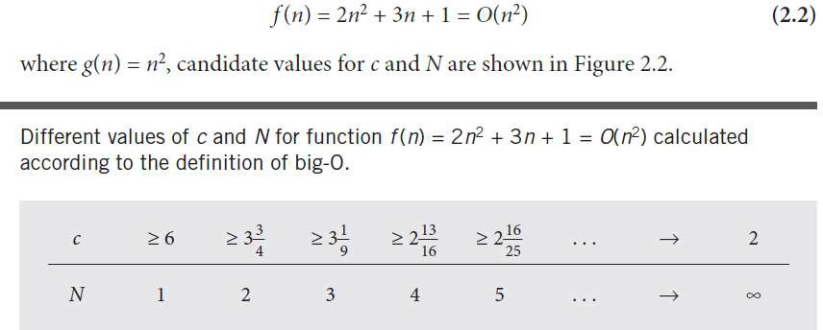
How to choose c and N
Here N is same as n₀

Slide 35
More Examples
35
Show that 3n+3 is O(n).
– Show ∃c, n₀: 3n+3 ≤ cn, ∀n>n₀ .
3+3/n <=c ….
n₀=1 c>=6
n₀=2 c>=4.5 so on
Show that 2n+2 is O(n).
– n₀=1 , c>=4
– c=3, n₀=2.

Slide 36
More Examples
36
Show that 2n² + 2n+2 is O(n²).
Hold if we let c=6, n₀=1.
Hold if we let c=5, n₀=2
Hold if we let c=4 n₀=2
Show that 3n² + 3n+3 is O(n²).
Hold if we let c=9, n₀=1.
Hold if we let c=7, n₀=3

Slide 37
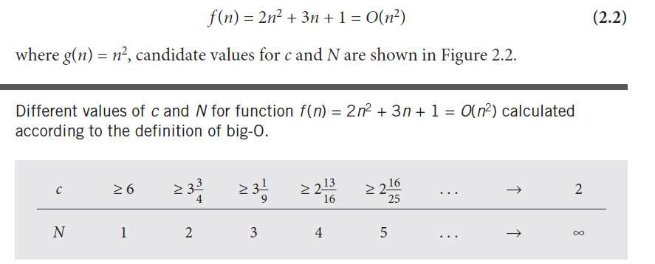
How to choose c and N
Here N is same as n₀
The crux of the matter is that the value of c depends on which N is chosen, and vice versa.
To choose the best c and N, it should be determined for which N a certain term in f
becomes the largest and stays the largest.
In Equation 2.2, the only candidates for the largest term are 2n² and 3n;
these terms can be compared using the inequality 2n² > 3n that holds for n > 1.5. Thus, N = 2 and c ≥ 3}

Slide 38
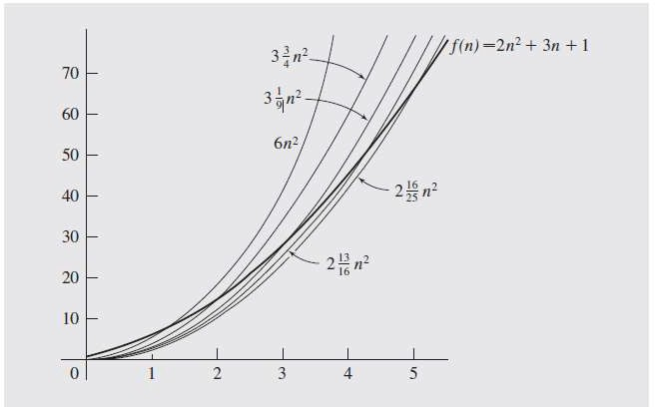
How to choose c and N
The point is that f and g grow at the same rate.
g is almost always greater than or equal to f if it is multiplied by a constant c.
Al

Slide 39
Big-O example, graphically
39
Show that 30n+8 is O(n).
Show ∃c,n₀: 30n+8 ≤ cn, ∀n>n₀ .
Let c=31, n₀=8. Assume n>n₀=8. Then
cn = 31n = 30n + n > 30n+8, so 30n+8 < cn.
Note 30n+8 isn’t less than n anywhere (n>0).
It isn’t even less than 31n everywhere.
But it is less than 31n everywhere to the right of n=8.
cn = 31n
30n+8
Value of function →
30n+8
∈O(n)
n
n>n₀=8 →
Increasing n →
Page:39
Algorithm Complexity

Slide 40
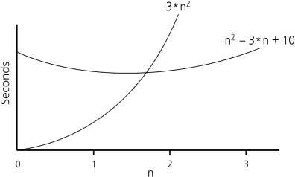
Example
40CENG 213 Data Structures
For n²–3n+10 Find constants c and n₀ exist such that
cn² > n²–3n+10
c is 3 and n₀ is 2
3n² > n²–3n+10
for all n ≥ n₀ .
for all n ≥ 2 .
Thus, the algorithm requires no more than kn² time units for n ≥ n₀ , So it is O(n²)

Slide 41
Big Oh Example
41
There is no unique set of values for n₀ and c in proving the asymptotic bounds
Prove that
100n + 5 = O(n²)
– 100n + 5 ≤ 100n + n = 101n ≤ 101n²
for all n ≥ 5
n₀ = 5 and c = 101 is a solution
– 100n + 5 ≤ 100n + 5n = 105n ≤ 105n²
for all n ≥ 1
n₀ = 1 and c = 105 is also a solution
Must find SOME constants c and n₀ that satisfy the asymptotic notation relation

Slide 42

ALGORITHM ANALYSIS OF DIFFERENT CODES

Slide 43
Nested For Loops
43
For Loop can be confusing as three statements are embedded in one …As T(N) is rough estimate, so some analysis use 1 for entire for loop …1 cost for each line or step
sum = 0;
for(i=0; i<N; i++) for(j=0; j<N; j++)
sum += arr[i][j];
O(1)
O(N)
𝑂(𝑁²)
O(N²)
T(N) ≈O(1) + O(N) + O(N²) + O(N²) = O(N²)
The total number of times a statement executes = outer loop times * inner loop times
Pag

Slide 44
Nested For Loops
44
Rough estimate
for(i=0; i<N; i++) arr[i][i] =0;
sum = 0;
for(i=0; i<N; i++) for(j=0; j<N; j++)
sum += arr[i][j];
O(N)
O(N)
O(1)
O(N)
O(N²)
O(N)²
O(N)+O(N²) = O(N²)

